Slide 1

CS 533 INTRO TO DATA SCIENCE
Michael Ekstrand

Slide 2
BUILDING AND EVALUATING MODELS

Slide 3

Learning Outcomes (Week)
Build and refine a predictive model
Construct features for a model
Apply regularization to control features and their interaction
Measure a model’s effectiveness and other behavior
Photo by Hannah Olinger on Unsplash

Slide 4
Where We’re At
Linear regression (continuous prediction)
Logistic regression (binary classification)
Optimizing objective functions
Minimize loss functions (e.g. squared error)
Maximize utility functions (e.g. log likelihood)

Slide 5
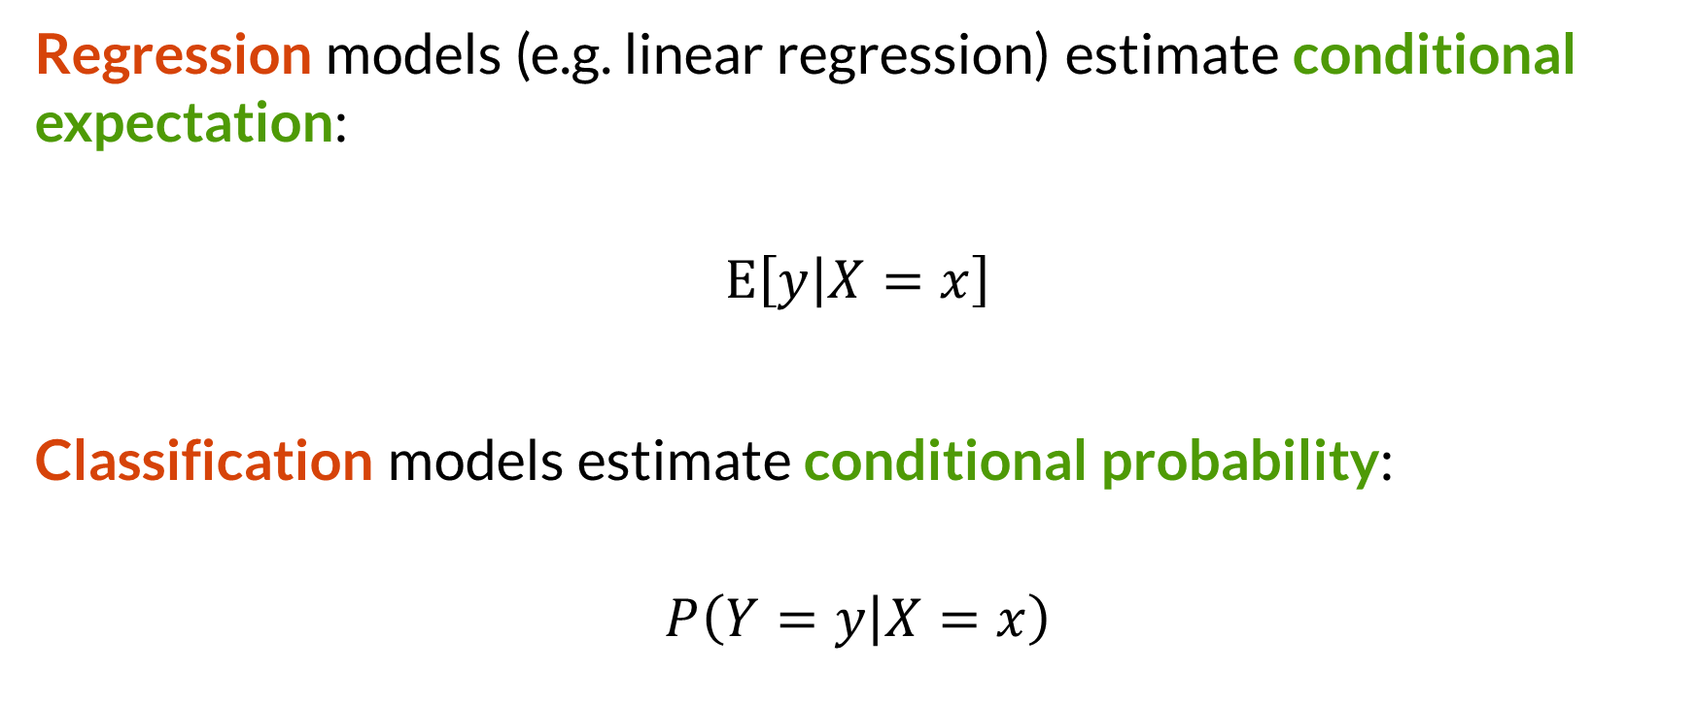

Conditional Estimates
Regression models (e.g. linear regression) estimate conditional expectation:
$$E\left[y | X=x\right]$$
Classification models estimate conditional probability:
$$P\left(Y=y | X=x\right)$$

Slide 6
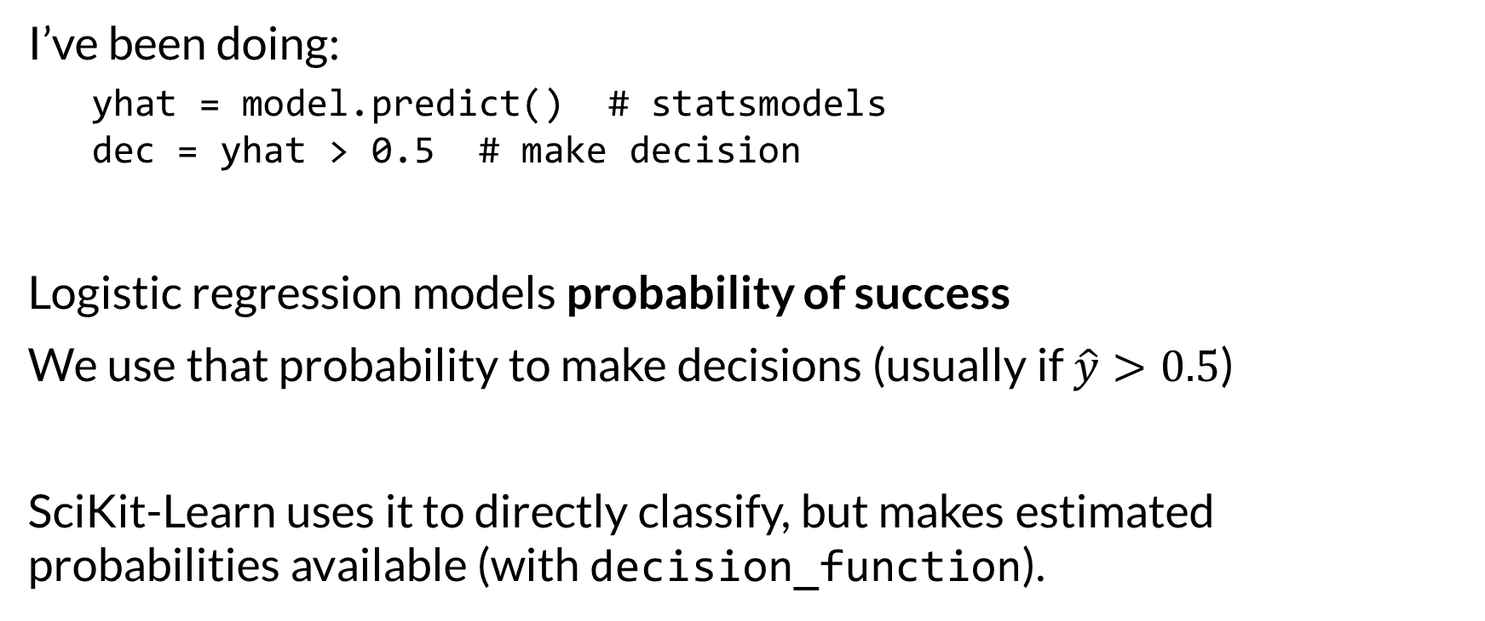
Distinction: Model Probability vs. Make Decision
I’ve been doing:
yhat = model.predict() # statsmodels dec = yhat > 0.5 # make decision
Logistic regression models probability of success
We use that probability to make decisions (usually if $\hat{y}>0.5$)
SciKit-Learn uses it to directly classify, but makes estimated probabilities available (with decision_function).

Slide 7


Trick: Probability and Expectation
If $𝕀_{A}\left(x\right)$ is an indicator (or characteristic) function
$$𝕀_{A}\left(x\right)=f\left(x\right)=\left\{\begin{aligned}1, X∈A \\ &0, X∉A\end{aligned}\right.$$
Then:
$$E\left[𝕀_{A}\left(X\right)\right]=P(A)$$

Slide 8

Wrapping Up
We are building models that estimate conditional probability or expectation and use them to make classifications.
We’re going to see more about their inputs and outputs this week.
Photo by Klim Musalimov on Unsplash

